Slide 1

Lazy Bob - SDP23 Team 5
Omar Areiqat, Vedatman Basu, Redwan Rahman, Jina Song
Notes:
Gina

Slide 2
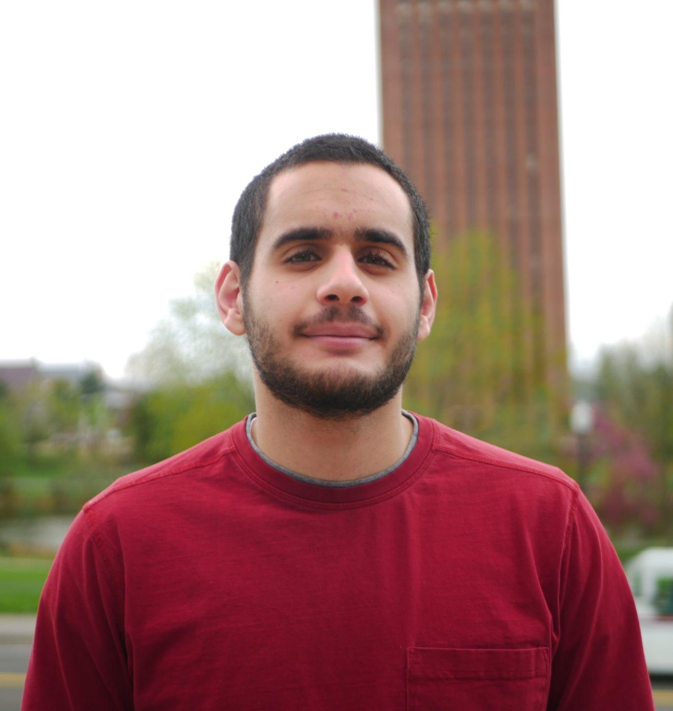
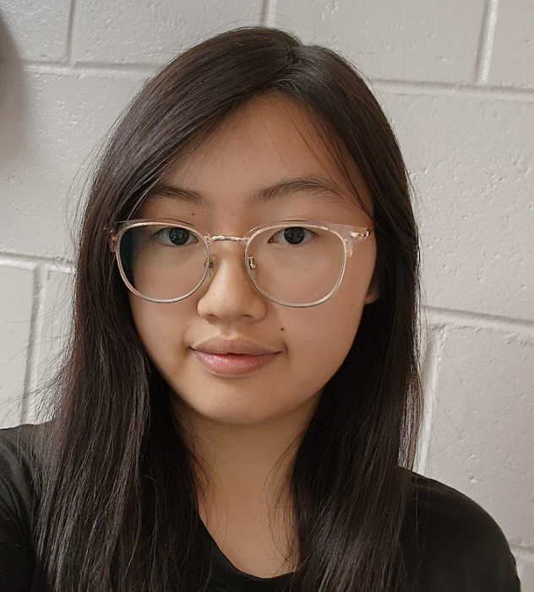



The Team
Omar Areiqat
CompE
Budget Lead
Movement and Power
Jina Song
EE
PCB Lead
Design
Vedatman Soham Basu CompE
Software Lead
Sensors
Redwan Rahman
CompE
Logistic Lead
Positioning
William Leonard
Advisor
Notes:
Individual

Slide 3

Problem Statement
Some people struggle with mundane actions in life, such as passing dishes on a large table.
Lazy Susans are nice, but only work on round tables and requires user to have reach.
What if there was a small, portable device that can move dishes across any table of arbitrary shape?
https://en.wikipedia.org/wiki/Lazy_Susan
Notes:
Soham

Slide 4
Our Solution
“Lazy Bob”: A moving coaster that approaches the user when called.
Stably transport items around a table to different users
Provide a simple way to interface with all coasters
Adapt to its environment
Notes:
Redwan

Slide 5

Purple: Caller
Yellow: Random Object
Plate 2
Coaster
Coaster
Coaster
θ
Coaster
Coaster
Coaster
Plate 5
r
Plate 1
HQ
Plate 3
Plate 4
Notes:
Omar

Slide 6
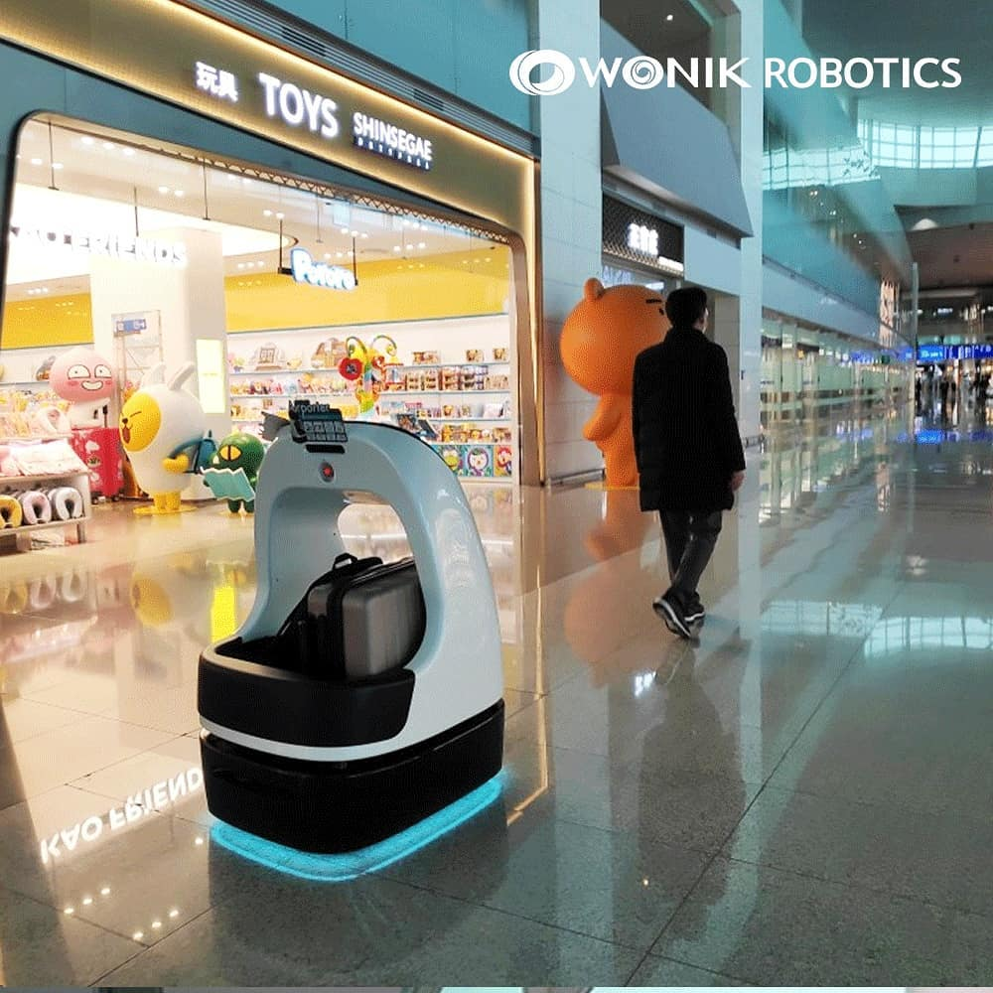
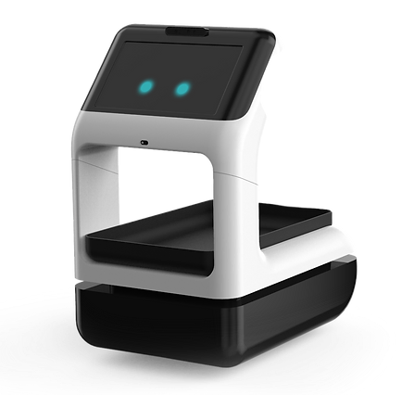
Similar Product: AirPorter
Autonomous-driving capability that allows baggage to be delivered to the designated destination​
Obstacle avoidance capability with dynamic obstacle detection
Size constraints, not sold commercially
https://www.wonikrobotics.com/delivery
Notes:
Gina Has all the features we need but the bigger size introduces more constraints; dining room may not be big enough, more awkward to move around in

Slide 7
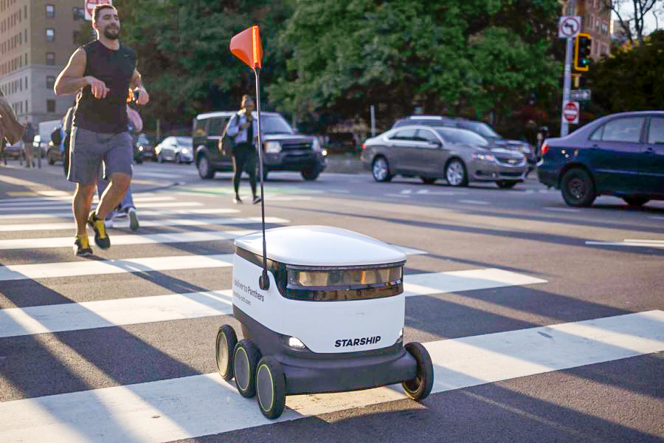
Similar Product: Starship Delivery Robot
An autonomous device that carries items over short distances
Uses twelve cameras, ultrasonic sensors, radar, neural networks, etc. to detect obstacles
Uses computer vision and GPS for location
https://pittnews.com/article/160259/news/starship-robots-may-return-in-future-under-new-dining-contractor/
Notes:
Gina

Slide 8
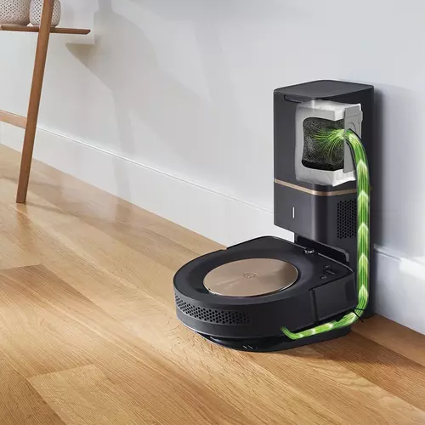
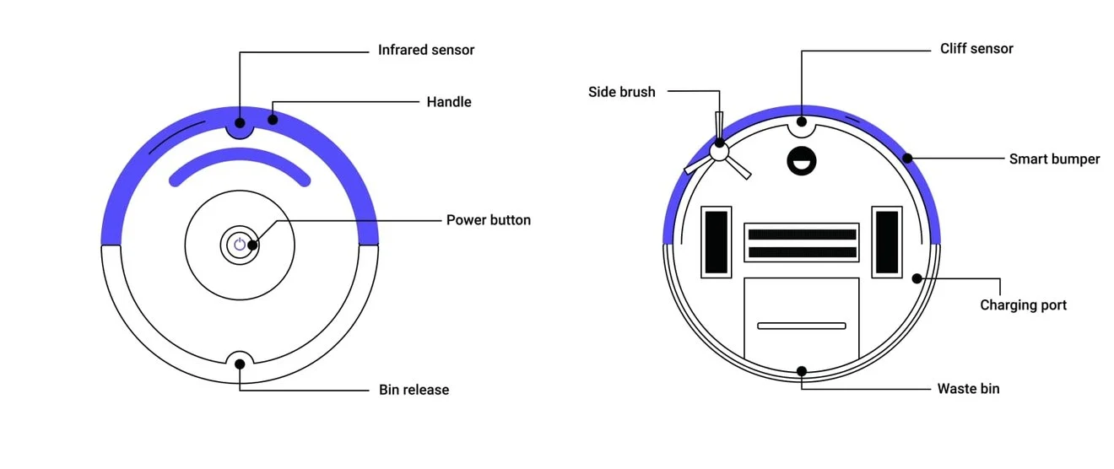
Similar Product: Robot Vacuums
Collision avoidance
Cliff detection
They use image processing, sensors
https://www.irobot.com/en_US/roomba-vacuuming/robot-vacuum-irobot-roomba-s9-plus/S955020.html
https://www.thezebra.com/resources/home/how-roomba-works/
Notes:
Soham

Slide 9

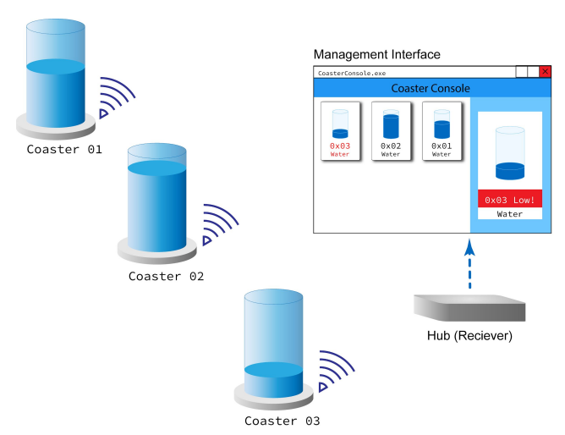
Similar Product: Smart Coaster
(SDP 20 Team 16)
A wireless coaster system that notifies wait staff when a customer's drink is almost empty
Similarities: Wireless communication, rechargeable batteries
Differences: Inanimate, different purpose
http://www.ecs.umass.edu/ece/sdp/sdp20/team16/
Notes:
Soham

Slide 10
Similar Product: Comparison
 | Movement | Transport | Rechargeable | Avoid obstacles | Avoid cliff | Size | Call to location | Cost
AirPorter |  |  |  |  |  |  |  | N/A
Starship |  |  |  |  |  |  |  | N/A
Robot Vacuums
Smart Coaster |  |  |  |  |  |  |  | N/A
Lazy Bob
Notes:
Gina

Slide 11
System Specifications: Functional
Accelerate at a rate of 0.5 cm/s² towards the caller, up to 7 cm/s
Transport items without the items falling off
Detect the edges of the table
and avoid falling off
Avoid objects in its path and arrive at its destination
Support up to 3 lbs.
Test Plan
Use a tape measure to check the distance travelled every second
Put objects on moving coaster and watch if object falls
Watch if it falls off when caller is away from the table
Put objects in path and check if it bumps into object
Place an object that weighs 3 lbs and check if system is stable while moving
Notes:
Gina

Slide 12
System Specifications: Design
Test Plan
5. Watch it move towards hub on a
given signal
6. Call both coasters on a collision
course and see if they collide
7. Use tape measure
8. Find and put on irregular shaped
tables and check if they fall off
9. Line up objects to allow no path to
caller, see if system notifies caller
5. Move back to its hub
once determined not in use
6. System supports at least 2
coasters at the same time
7. Coaster diameter is within 25 cm
8. Be able to use it regardless of
table shape
9. If no path to caller is available,
indicate to caller
Notes:
Soham

Slide 13
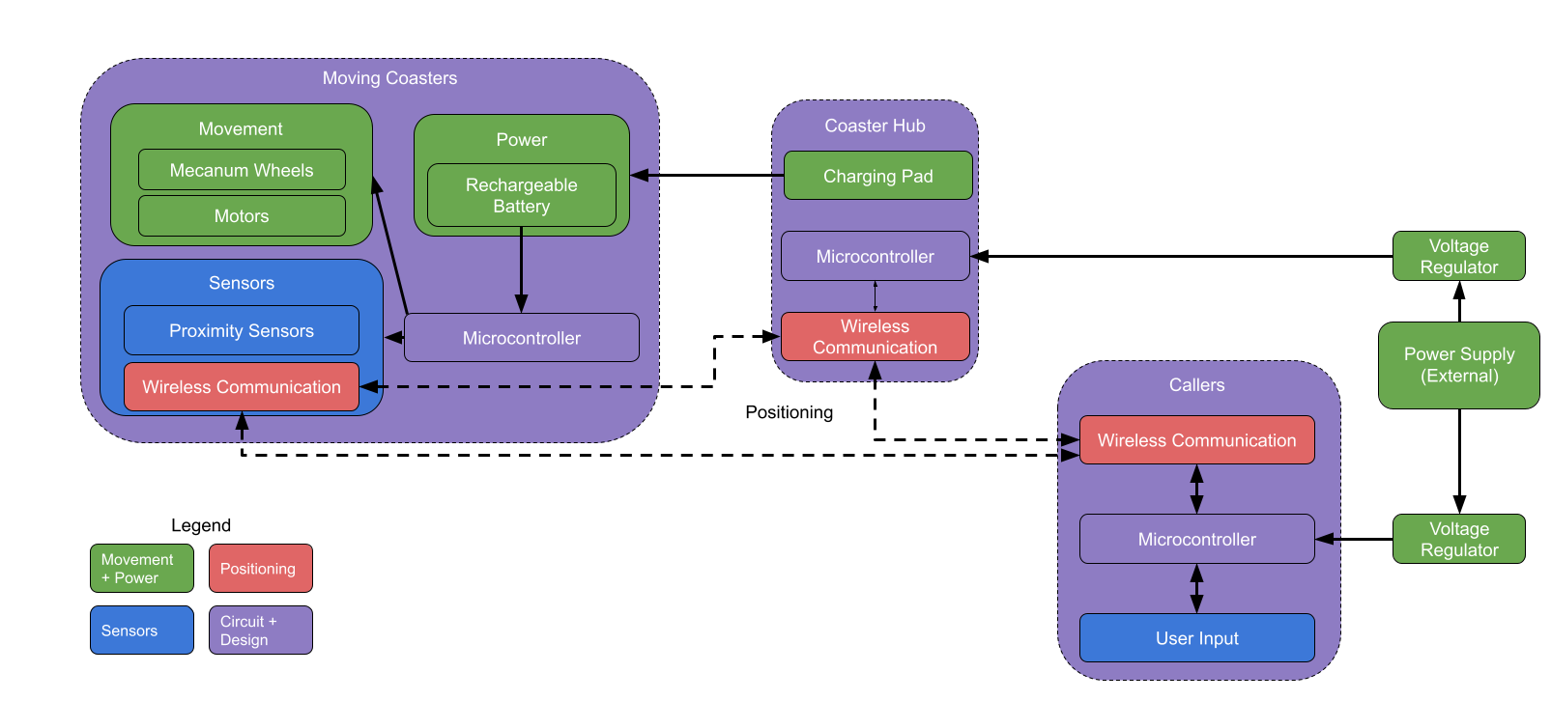
Hardware Block Diagram
Notes:
Gina

Slide 14
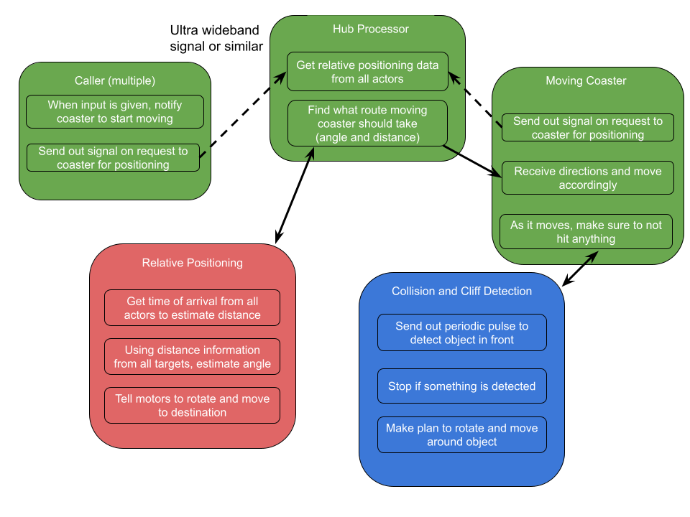
Software Block Diagram
Notes:
Redwan

Slide 15
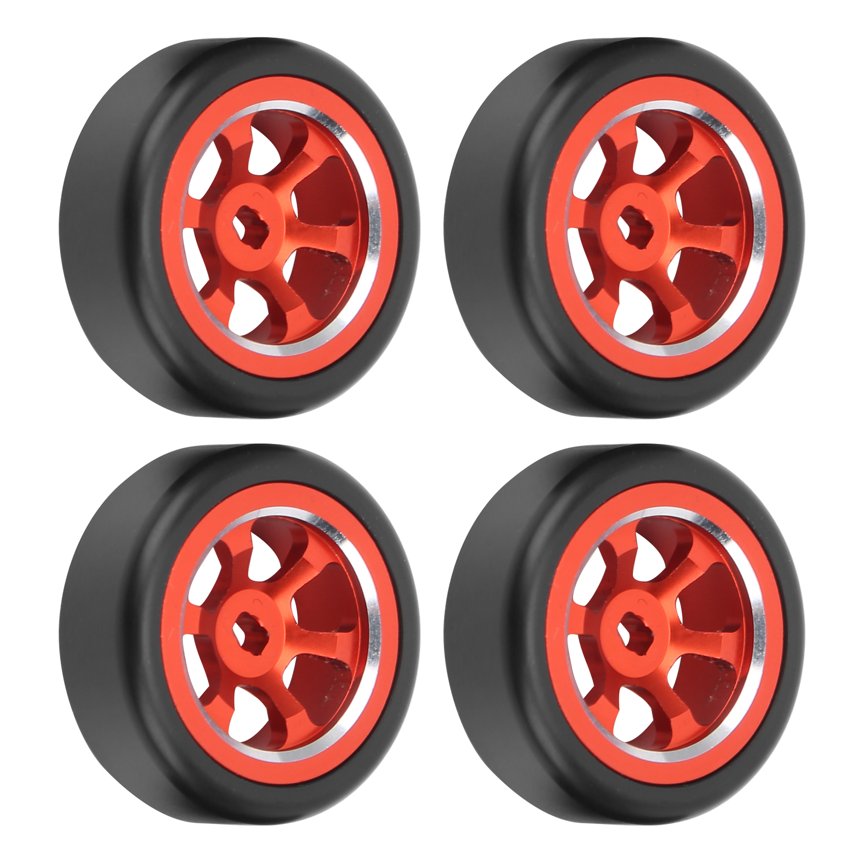
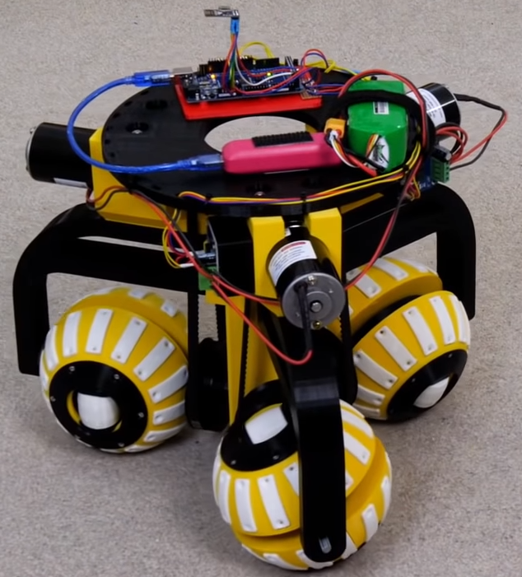
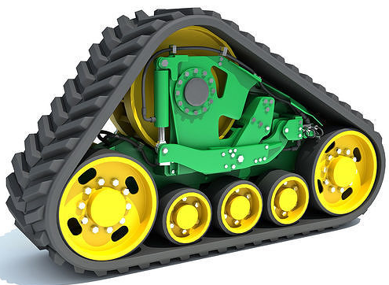
Subsystem: Motion
Requirements:
Omnidirectional
Precise
https://blog.arduino.cc/2021/06/05/james-brutons-robot-uses-three-ball-shaped-wheels-to-move-in-any-direction/
https://www.amazon.com/Drift-Metal-Accessories-Compatible-Wltoys/dp/B08YYR7FSY
https://www.cgtrader.com/3d-models/vehicle/industrial-vehicle/continuous-track
Notes:
Omar

Slide 16
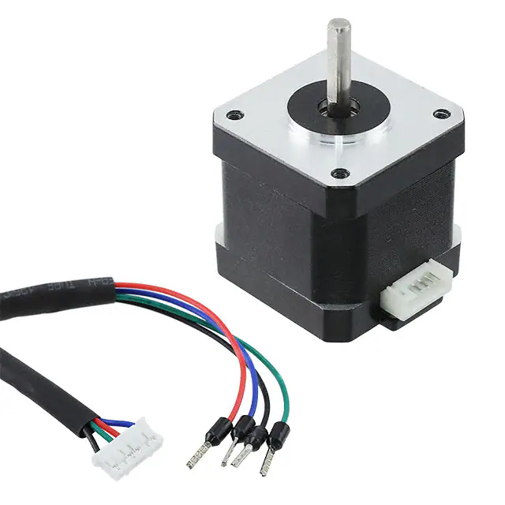
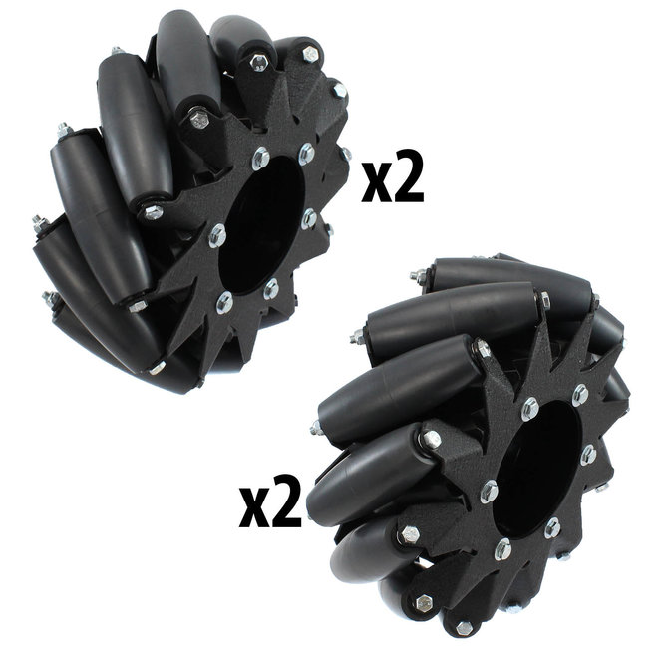
Subsystem: Motion
Requirements:
Omnidirectional
Precise
Plan:
Motor: 4x Stepper Motors
Wheels: 4x Mecanum Wheels
https://www.andymark.com/products/10-in-mecanum-wheel-set-steel-body-6-hole-bore
https://www.digikey.com/en/products/detail/dfrobot/FIT0278/6588458
Notes:
Omar

Slide 17
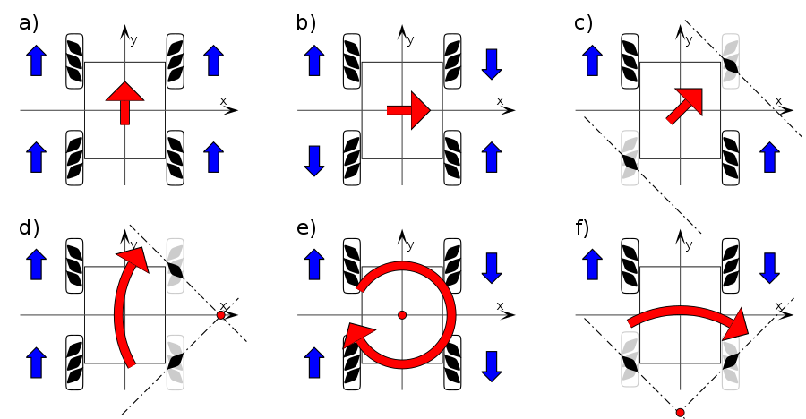
Subsystem: Motion
https://en.wikipedia.org/wiki/Mecanum_wheel
Notes:
Omar

Slide 18
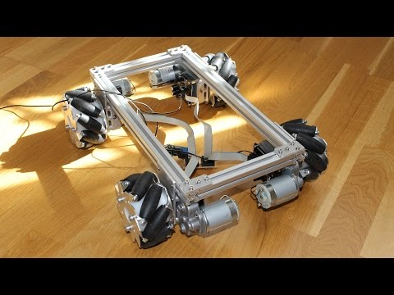
Subsystem: Motion
https://youtu.be/Ne09Y72zW_Y
Notes:
Omar

Slide 19
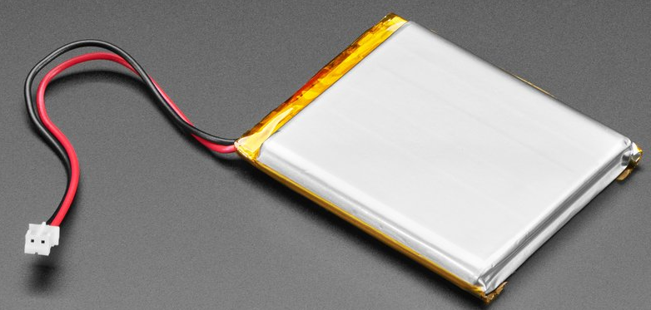
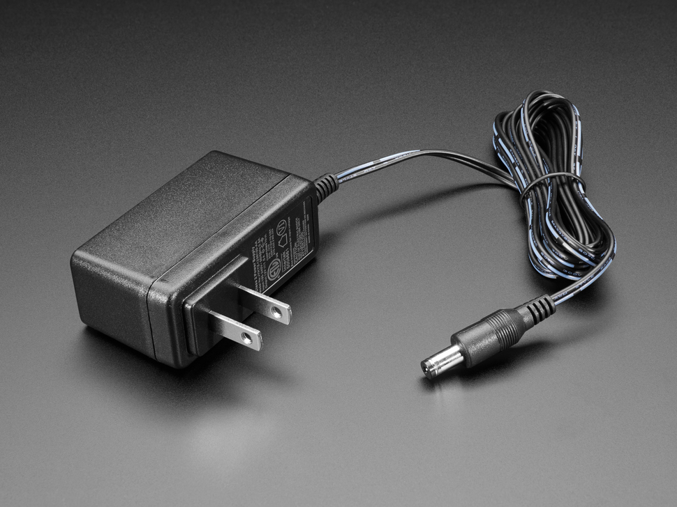
Subsystem: Power
Lithium-ion batteries
https://www.adafruit.com/product/328
https://www.adafruit.com/product/798
Notes:
Omar

Slide 20
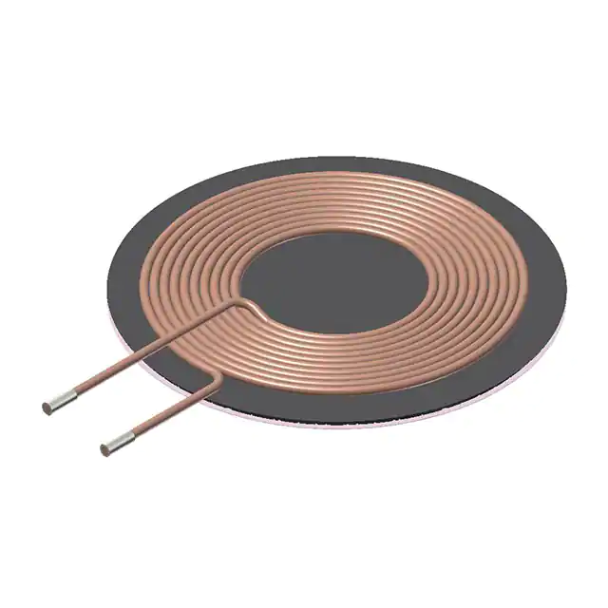
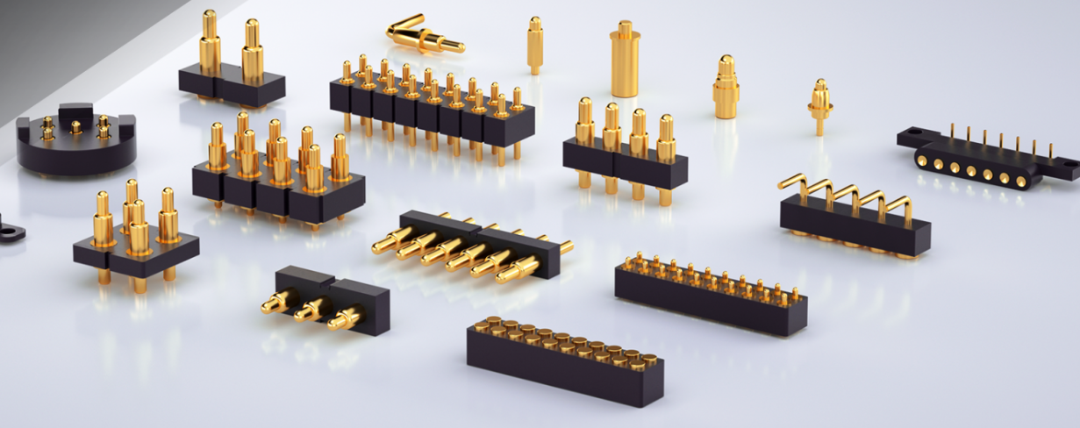
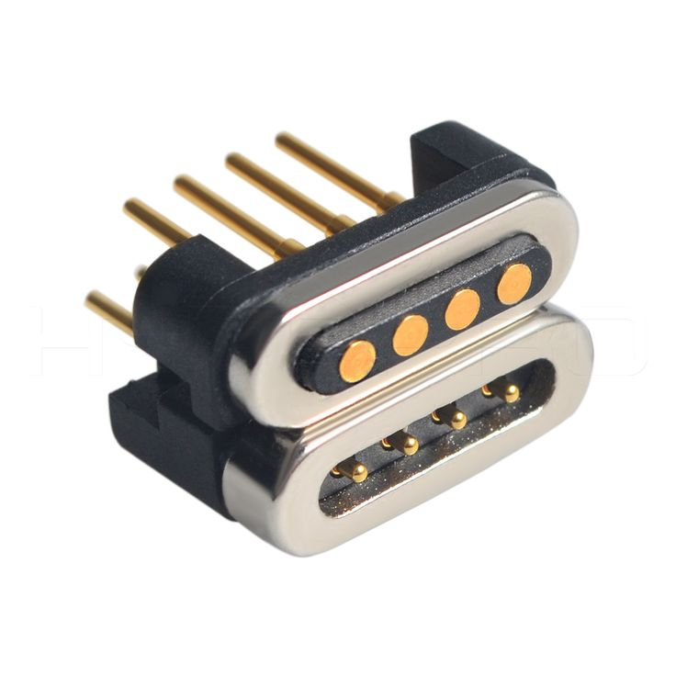
Subsystem: Charging
Connection
Pogo/Magnetic Pins
Wireless
https://www.digikey.com/en/products/detail/tdk-corporation/WT505090-10F2-A11-G1/8019490/
https://www.pinterest.com/pin/545498573615003623/
https://pogopin.net/
Notes:
Omar

Slide 21
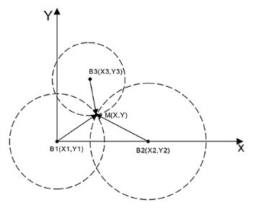
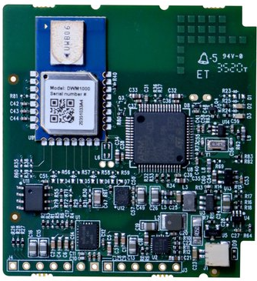
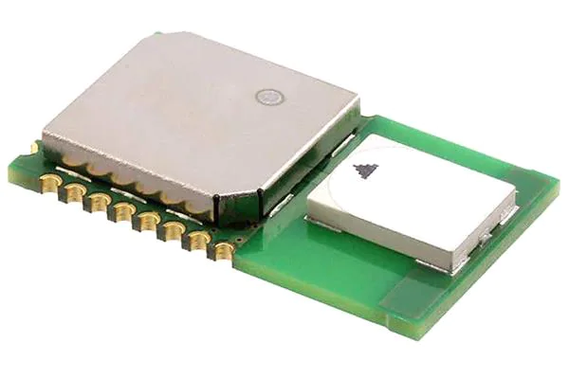
Subsystem: Relative Positioning
Triangulating relative position
Coaster, Hub, Active and Inactive Caller
Ultra Wideband Sensor
Time of arrival
High precision at small ranges
https://www.mouser.com/ProductDetail/Qorvo/DWM1000?qs=TiOZkKH1s2R6b5D6df63Pg%3D%3D
https://www.tindie.com/products/petteemfg/ultra-wideband-rtls-uwb-diy-starter-kit/#specs
https://www.frontiersin.org/articles/10.3389/fnbot.2022.715440/full
Notes:
Redwan

Slide 22
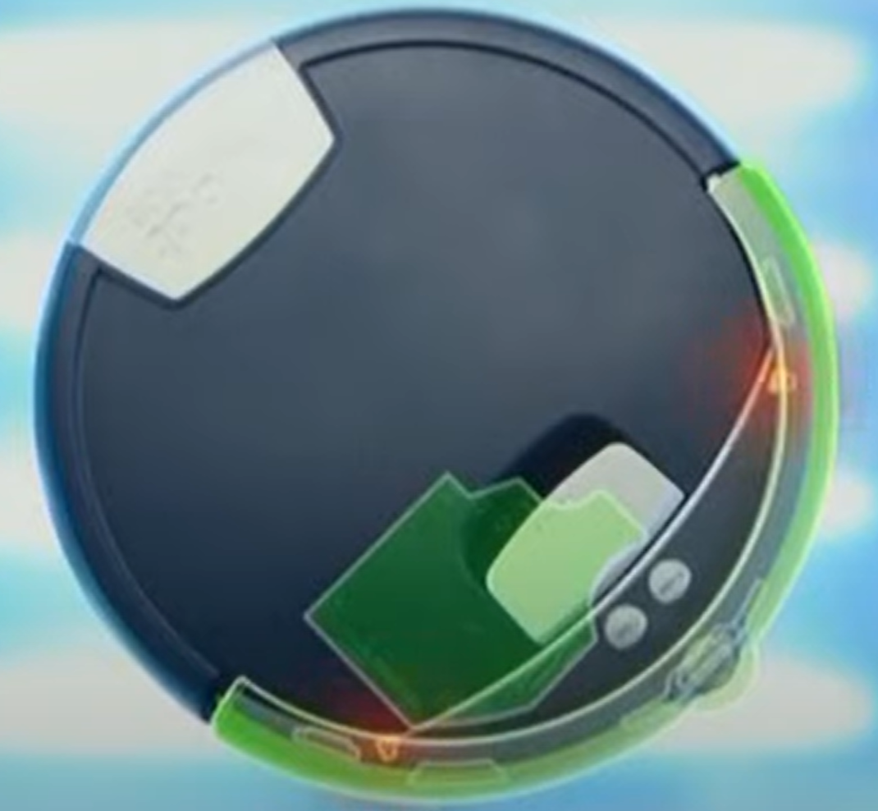
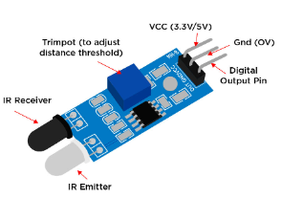
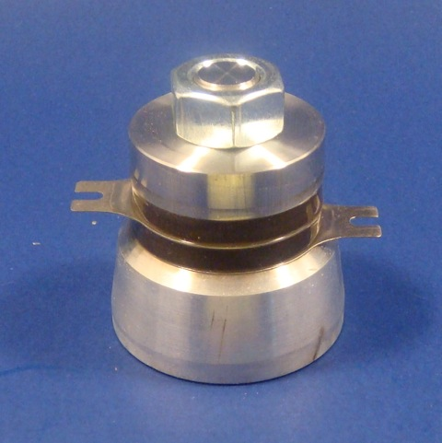
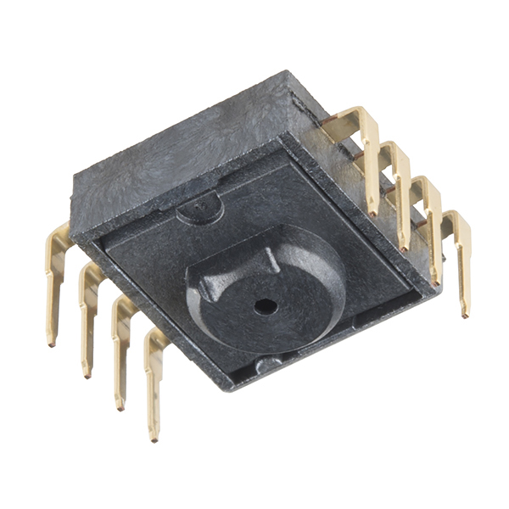
Subsystem: Collision and Cliff Detection
Piezoelectric
Calibration
Ultrasonic
Distance measurement
Photocell/Infrared
Cliff Detection & Collision Detection
Stretch Goal: Optic Sensors
Mapping
https://www.youngwonks.com/blog/What-is-an-infrared-sensor
https://www.americanpiezo.com/piezo-theory/whats-a-transducer.html
https://www.sparkfun.com/products/retired/12907
Notes:
Soham

Slide 23
Estimated Cost
Item | Quantity | Price per | Total
MCU | 6 | $ 8.00 | $ 48.00
UWB sensor | 6 | $ 17.00 | $ 102.00
PCB | 4 | $ 25.00 | $ 100.00
Motors | 10 | $ 7.60 | $ 76.00
Wheels | 9 | $ 4.50 | $ 40.50
Battery and Charging | 3 | $ 15.00 | $ 45.00
Collision Sensors | 5 | $ 7.15 | $ 35.75
Cliff Detection Sensor | 3 | $ 5.00 | $ 15.00
Input Device | 6 | Owned | $ 0.00
Total |  |  | $ 462.25
Notes:
Omar
*PCB based off first iteration assuming 2 layers of 200x200mm size, plus $12 for shipping

Slide 24
MDR Deliverables
1 Moving Coaster
Moves properly and accurately
Accurately detects positioning
Goes to location when called
Can detect if an object is in the way
2 Callers
Can send signal to coaster and hub
1 Charging Hub
Can send signal to coaster and callers
Potentially charges system
Plans for PCB
Motor Pins
Microcontroller
Sensors
Communication
User input method
Notes:
Gina

Slide 25
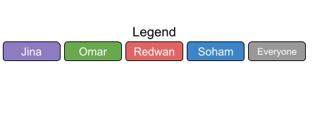
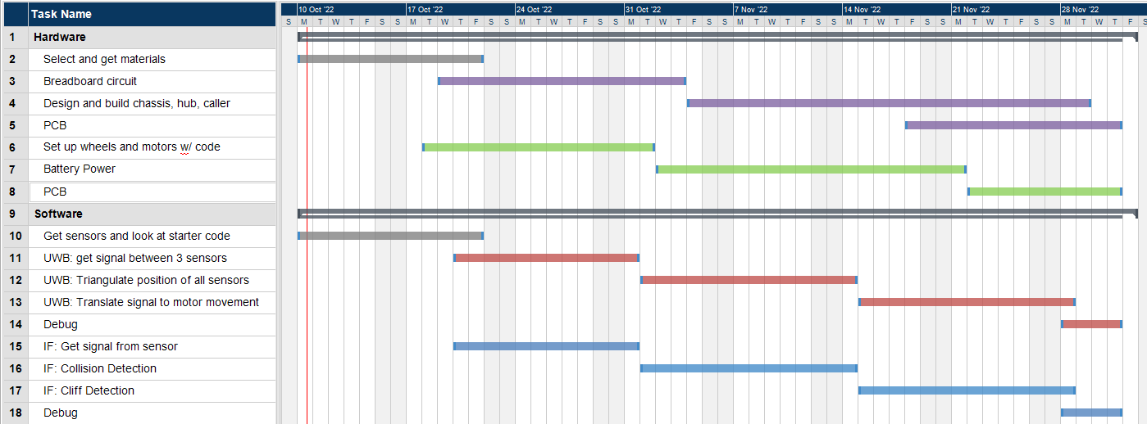
Gantt Chart
Notes:
Redwan

Slide 26
QUESTIONS & ANSWERS

